Slide 1

Electromagnetic Crosstalk: Inductive and Capacitive Coupling
Farhad Rachidi
Swiss Federal Institute of Technology (EPFL)
EMC Laboratory
Farhad.Rachidi@epfl.ch
http://emc.epfl.ch

Slide 2
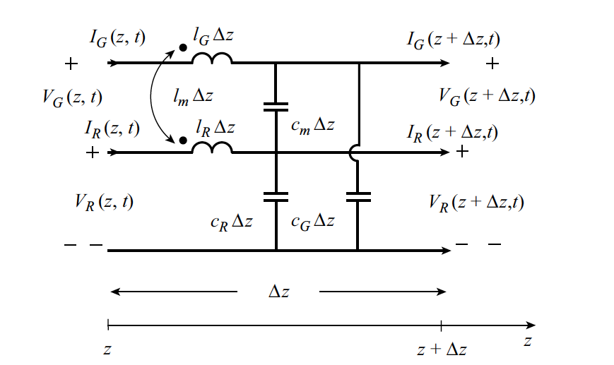
MTL Equations (From Chapter 6)
MTL equations:
and:
These are coupled partial differential equations. They can be written compactly in matrix form (see Chapter 6).

Slide 3
Weak Coupling Approximation
Weak Coupling approximation:
  Voltages and currents induced in the generator circuit due to the currents and voltages that were induced in the receptor circuit may be ignored.
  From the standpoint of MTL equations, the condition of weak coupling means that the equations for the generator circuit are approximated by neglecting the mutual terms, as
  The equations for the receptor
  circuit are unchanged:
X
X

Slide 4
Weak Coupling Approximation
The crosstalk under weak coupling approximation can be evaluated as follows:
We calculate the voltages and currents in the generator circuit as though it were an isolated, two-conductor transmission line:
The solutions are introduced in the source terms in the receptor circuit represented by the terms on the right-hand-sides
The solutions of the above equations provide the induced voltages and currents in the receptor circuit
Magnetic field coupling

Slide 5
Weak Coupling Approximation
The crosstalk under weak coupling approximation can be evaluated as follows:
We calculate the voltages and currents in the generator circuit as though it were an isolated, two-conductor transmission line:
The solutions are introduced in the source terms in the receptor circuit represented by the terms on the right-hand-sides
The solutions of the above equations provide the induced voltages and currents in the receptor circuit
Electric field coupling

Slide 6
Weak Coupling Approximation
The crosstalk under weak coupling approximation can be evaluated as follows:
We calculate the voltages and currents in the generator circuit as though it were an isolated, two-conductor transmission line:
The solutions are introduced in the source terms in the receptor circuit represented by the terms on the right-hand-sides
The solutions of the above equations provide the induced voltages and currents in the receptor circuit
These source terms can be represented by equivalent voltage and current sources distributed along the receptor line (see next vugraph)

Slide 7
Weak Coupling Approximation:
Equivalent Circuit for the Receptor Line

Slide 8
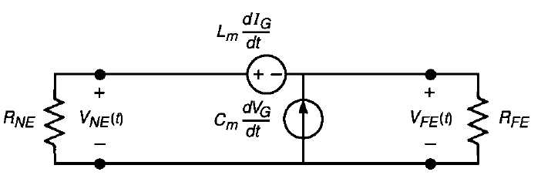
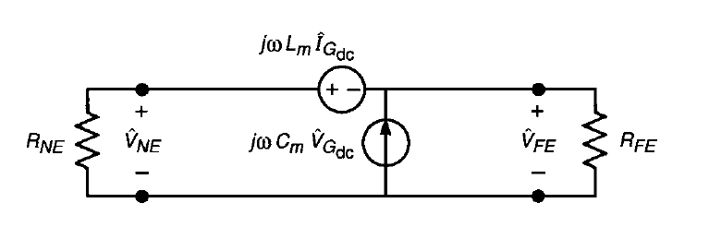
Weak Coupling Approximation:
Inductive-Capacitive Approximate Model
Assuming that the line is electrically short at the frequency of driving source in the generator circuit, the TL representation with the distributed parameters can be approximated by a lumped parameter circuit as follows:
And in the frequency domain:
Total inductance = l_{m}L
Total capacitance= c_{m}L
This is referred to as the inductive-capacitive model.
There are two key assumptions in this model:
(1) Weak coupling between the generator and the receptor circuits
(2) Electrically-short line (L<<λ=v/f)

Slide 9
Frequency-Domain Inductive-Capacitive Model
Current and voltage of the generator circuit (weak coupling approximation, electrically-short line):
Near-end and far-end cross-talk voltages:
Inductive coupling
Capacitive coupling

Slide 10
Frequency-Domain Inductive-Capacitive Model
Current and voltage of the generator circuit (weak coupling approximation, electrically-short line):
Near-end and far-end crosstalk voltages:
Substituting the expressions for the current and voltage in the generator circuit gives the final results for the crosstalk voltages (see next vugraph)

Slide 11
Frequency-Domain Inductive-Capacitive Model
Final expressions for near-end and far-end crosstalk voltages:
The crosstalk can be viewed as a transfer function between the source voltage (input) and the crosstalk voltages (output):
Question: which of the two terms (capacitive and inductive) dominates the coupling?

Slide 12
Frequency-Domain Inductive-Capacitive Model
Inductive coupling dominates when
and
where the characteristic impedances of each circuit in the presence of the other circuit are defined by
Capacitive coupling dominates when
and
‘Low’ impedances
‘High’ impedances

Slide 13
Frequency-Domain Inductive-Capacitive Model
Crosstalk transfer function
20 dB/decade
Question: What is f_{u} and what happens beyond this frequency?
f
f_{u}

Slide 14
Frequency-Domain Inductive-Capacitive Model
Total
Inductive
Low impedance loads
Capacitive
f
Total
Capacitive
Inductive
High impedance loads
f

Slide 15
Calculation of Inductances and Capacitances
Which of the following statement is correct?
Inductances are generally more difficult to be evaluated than capacitances
Capacitances are generally more difficult to be evaluated than inductances
They are equally difficult

Slide 16
Calculation of Mutual and Self Inductances
Two alternate and equivalent ways to compute inductances:
1. Faraday Law
2. Neumann Formula
No anisotropic magnetic material present, the reciprocity principal implies that

Slide 17
Circular Concentric Loops
K() and E() are the complete elliptic integrals, defined as

Slide 18
Circular Concentric Loops
For the case when a << d, the parameter k is small and F(k) can be expanded in a small-argument approximation, giving the following expression for M
Overlapping loops 1 and 2, we obtain the self inductance
For loops where r_{o} << a, this expression is approximated by

Slide 19
Two Parallel Conductor Segments

Slide 20
Two Parallel Conductor Segments

Slide 21
Self-Inductance of a Square Loop
The self inductance of a square loop of radius r_{o} and side length a can be expressed as (letting p = a/r_{o})
and for loops where r_{o} << a, this expression is approximated by
Note that in these calculations of the self inductance, the contribution by the internal flux within the conductor has been neglected. This term, which is most important at low frequencies when the current is uniformly distributed across the cross-section of the conductor, is given as

Slide 22
Calculation of Self and Mutual Capacitances
Capacitance of two metallic objects

Slide 23
Calculation of Self and Mutual Capacitances
The estimation of the self and mutual coupling capacitances of wire-like structures is more difficult than for the inductances discussed previously.
This is because the capacitances depend on the charge distributions on the coupling elements and these distributions can change, depending on the details of the local geometry surrounding the wires. In the case of the inductances, the current flow in the wires was assumed to be a constant, and independent of the loop geometry.

Slide 24
Capacitance of Two Parallel Wires
To illustrate the calculation of the capacitances for use in the coupling model, consider the idealized geometry of two parallel, thin cylindrical wires of total length 2L₁ and 2L₂, radii a₁ and a₂ and a separation d, as illustrated in the figure below. Each wire has a pair of terminals at the center of the conductor, and voltages V₁ and V₂ can be either impressed or measured at these locations.
The capacitance of this two wire structure is defined by a matrix relationship between V₁ and V₂ defined at the two terminals and the electric charge residing on the wires. Letting Q1 be the charge on the upper half of wire 1 and Q2 be the charge on wire 2 (with - Q₁ and -Q₂ on the lower half of the wires), the charge-voltage relationship is written as

Slide 25
Capacitance of Two Parallel Wires
The charges are given by
To determine the C_{ij} terms, it is necessary to determine the charge distributions on each wire. These charge distributions are used to compute the electric potential at any observation point denoted by by integrating over the wires, as

Slide 26
Capacitance of Two Parallel Wires
By imposing voltages V₁ and V₂ at the terminals of the wires, the top halves of the conductors are maintained at constant potentials of +V₁/2 and +V₂/2, and the bottom halves are at -V₁/2 and –V2/2. Letting the observation point approach each of the conductors results in a set of coupled integral equations for the charges.
These integral equations can be solved numerically by the moment method.
This involves representing the charge densities by n basis (or expansion) functions on each wire, and then matching the above equation at n locations on each of the wires. This results in a (2n2n) matrix equation that must be inverted numerically. If the charges on the conductors are represented by a sum of pulse functions of width D, integrals of the form
must be evaluated. The terms z_{i} and z_{j} denote the source and observation location along the axis of the cylinders. When the source and observation points are located on different wires, the term K in equation above is given by K = a₁. For z_{i} and z_{j} on the same wire, K = a₂. The integral is well defined and is approximated by

Slide 27
Capacitance of Two Parallel Wires
When , the above can be approximated as

Slide 28
Capacitance of Two Parallel Wires

Slide 29
Recall: Equivalent Circuit for Weak Coupling

Slide 30
Example: Cross-Talk between Two Parallel Traces on a Printed Circuit Board
Cross-section
Receptor line
(victim)
Driven line
Ground plane
Permittivity
Voltage
Source V_{s}
Dielectric substrate
Load impedance
Z_{s}
Ground plane

Slide 31
Example: Cross-Talk between Two Parallel Traces on a Printed Circuit Board
A typical size of a PCB is such that the lengths of the lines L are on the order of 5 cm. Based on the criteria that the wavelength of the EMI must be such that λ>10 L for the low frequency modeling approach to be valid, we note that the maximum frequency for this analysis will be f_{max} = c/λ = c/10L = 600 MHz.
For pulsed signals within the PCB, this bandwidth limitation implies that the low frequency model is valid for pulses having a 10% to 90% rise-time of t_{r} 0.44/f_{max} , or about 0.7 ns. Data transmission can occur on lines having much larger dimensions, e.g., L = 5 m. In this case, the corresponding maximum frequency is equal to 6 MHz, with a maximum rise time of 70 ns.
In this example, the primary line is excited by a lumped voltage source located at one end, and this induces a current I₁ to flow in the line. Thus, in this configuration there is a significant magnetic flux coupling to the receptor. However, the voltage source V_{s} also produces a charge density on the excitation line, and this gives rise to capacitive coupling between the two lines. Both of these coupling mechanisms must be considered.

Slide 32
Example: Cross-Talk between Two Parallel Traces on a Printed Circuit Board
For long, straight circular wire conductors located over a perfect ground with no dielectric layer, the mutual inductance and capacitance elements M and Co discussed in the previous sections can be calculated from available expressions for the per-unit-length inductance and capacitance values for multiconductor lines.
For the present case, however, the PCB traces are not circular, but appear as strip conductors having a width w and a separation d. Furthermore, the presence of the dielectric material affects the value of the capacitance. The capacitance and inductance of these traces can differ significantly from those of the circular wires, and a numerical calculation is generally needed to determine these parameters.
As a numerical example, assume that the overall PCB trace lengths are L=5cm, the edge-to-edge conductor separation is d = 0.5 cm, the conductor widths are w = 0.2 cm, and the dielectric substrate thickness is t = 0.1 cm. The relative permittivity ε_{r} = 3.6, which is typical of a plastic material. Using the MSTRP.FOR program*, the per-unit-length line parameters may be determined, and the corresponding total mutual inductance and capacitance for the 5cm line is given by M = 4.131 x 10⁻¹⁰ henries and Co = -3.607x10⁻¹⁴ farads.
*Paul, C. R., Analysis of Multiconductor Transmission Lines, John Wiley & Sons, New York, 1994.

Slide 33
Example: Cross-Talk between Two Parallel Traces on a Printed Circuit Board
Under the assumption of weak coupling, the current and voltage responses in the driving line, I₁ and V₁, can be expressed in terms of the source excitation voltage, V_{s} as
V₁

Slide 34
Example: Cross-Talk between Two Parallel Traces on a Printed Circuit Board
For the victim line:

Slide 35
Example: Cross-Talk between Two Parallel Traces on a Printed Circuit Board

Slide 36
Example: Cross-Talk between Two Parallel Traces on a Printed Circuit Board

Slide 37
Example: Cross-Talk between Two Parallel Traces on a Printed Circuit Board
Numerical example:
L = 5 cm, d = 1 cm, a1 = a2 = 0082 cm.
(characteristic impedance of a single trace Z_{o} ≈ 150 W)
M = 3.466 nH, and C_{o} = -0.1573 pF.
Assuming Z_{s} = Z_{L} = Z_{a} = Z_{b} = Z_{c} = 150 Ω, the load voltages become

Slide 38
Example: Cross-Talk between Two Parallel Traces on a Printed Circuit Board
Z_{L} = 0
Z_{L} ➔ ∞

Slide 39
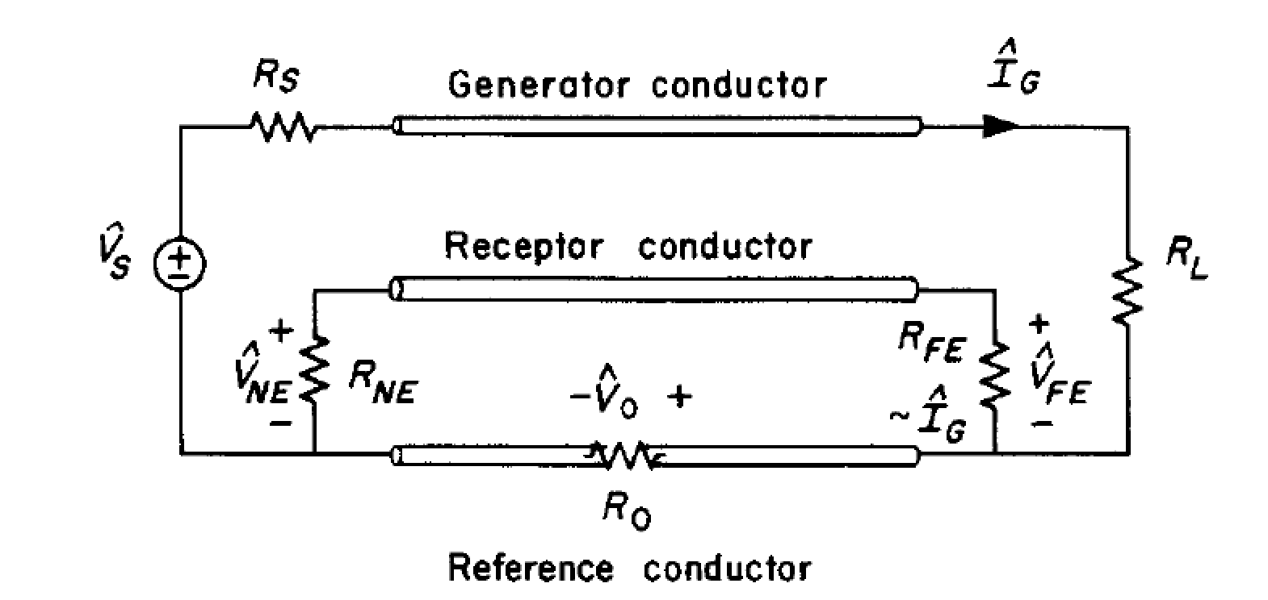
Frequency-Domain Inductive-Capacitive Model
Inclusion of Losses: Common-Impedance Coupling
So far, we have assumed a lossless line—perfect conductors and a lossless medium.
Imperfect conductors can produce significant crosstalk at the lower frequencies. This is referred to as common-impedance coupling.
The voltage drop across the reference conductor is therefore given by (for an electrically short line)
For typical loads and low frequencies,
R_{o} << R_{s}, R_{L}, R_{NE}, R_{FE}
This voltage appears directly in the receptor circuit, producing contributions to the crosstalk transfer functions at low frequencies (see next vugraph).

Slide 40
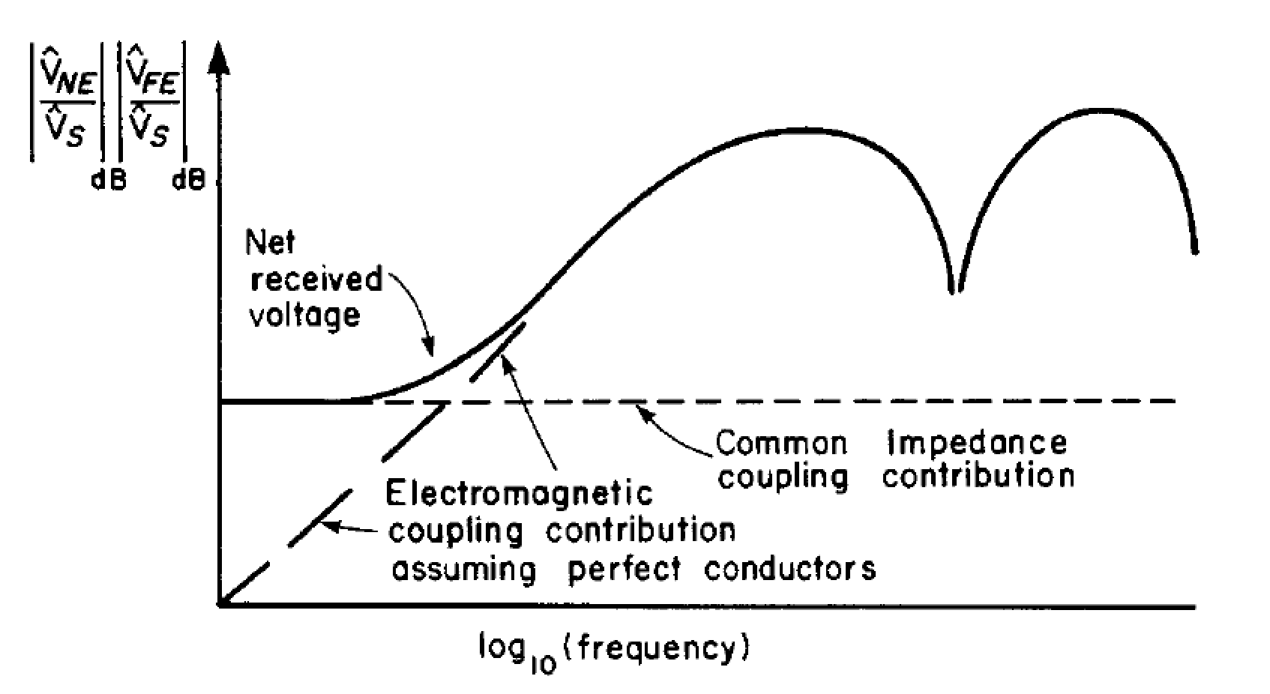
Frequency-Domain Inductive-Capacitive Model
Inclusion of Losses: Common-Impedance Coupling
Common-mode impedance coupling:
This produces an essentially frequency independent “floor” at the lower frequencies:
The total coupling is approximately the sum of the inductive, capacitive, and common-impedance coupling.

Slide 41
Time-Domain Inductive-Capacitive Model

Slide 42
Time-Domain Inductive-Capacitive Model
Response to a trapezoidal pulse train representing a clock or data signal

Slide 43
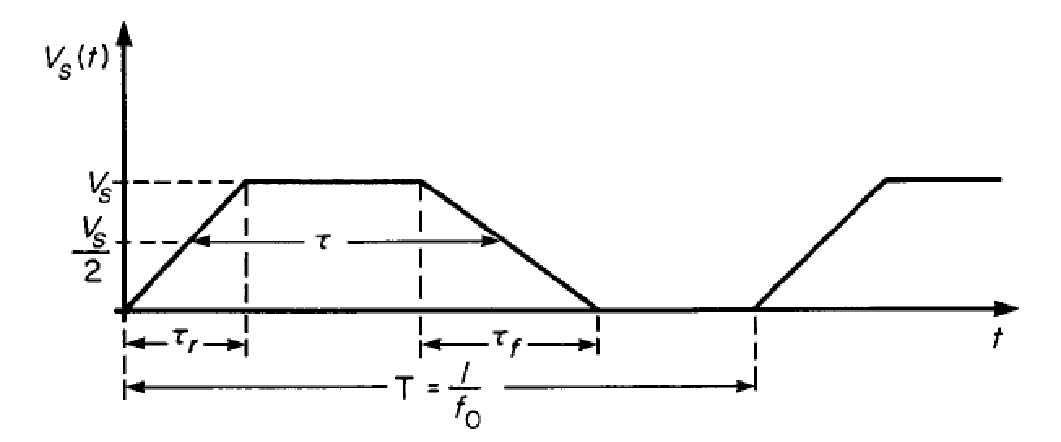
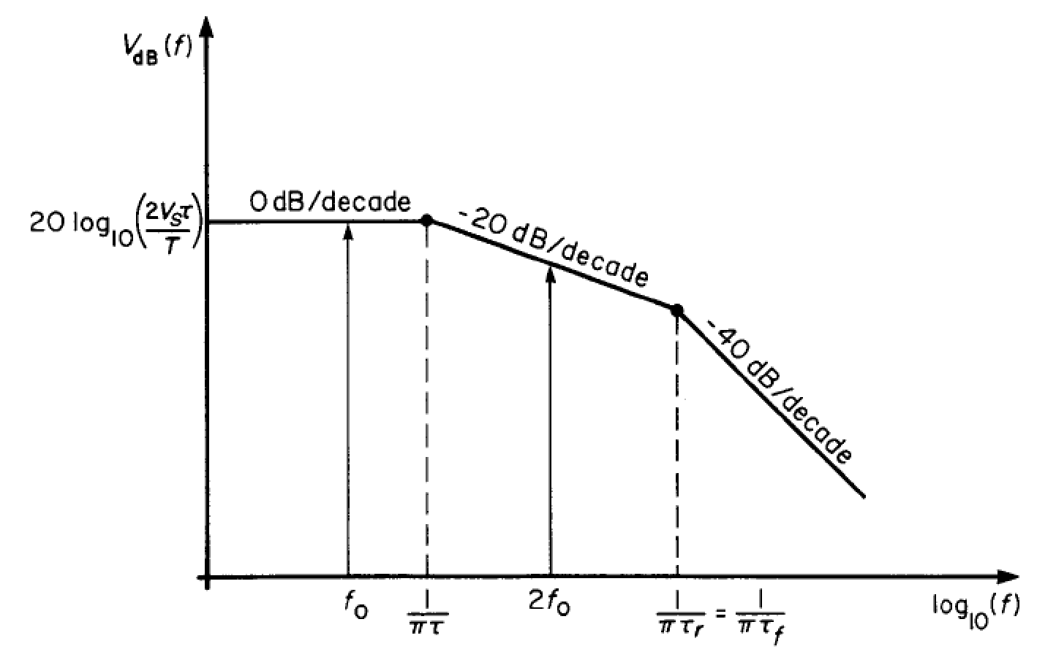
Time-Domain Inductive-Capacitive Model
Trapezoidal pulse train and its spectrum envelope
A reasonable criteria for the bandwidth of this signal is
In order for our approximate model to be valid the line length must be electrically short at this frequency:
That means
Where T_{D} is the one-way transit time (time delay) of the line. A reasonable choice for k would be 1/10. This gives the restriction on the pulse rise/fall times:

Slide 44
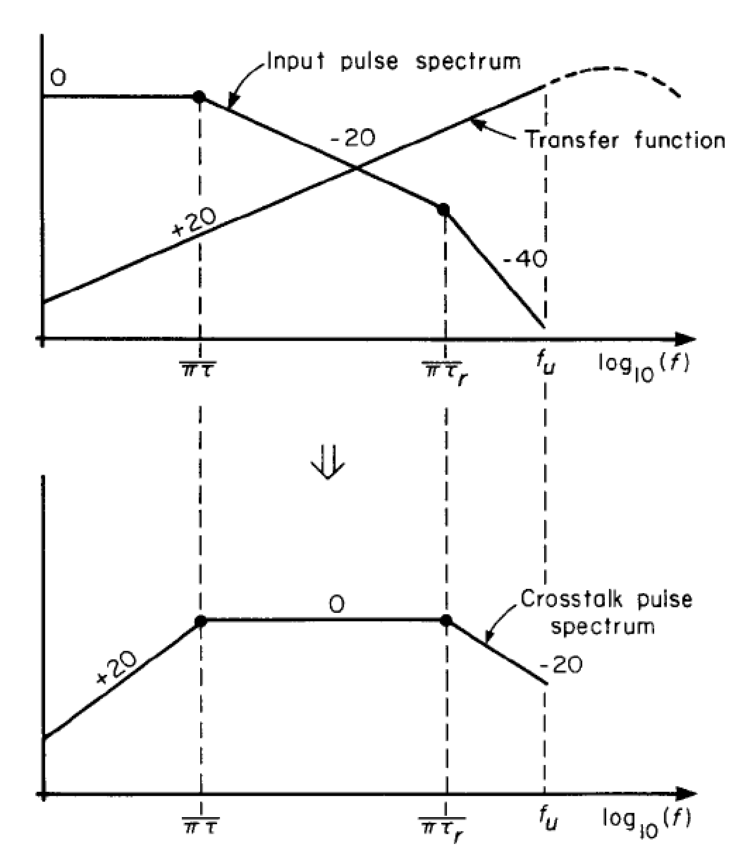
Time-Domain Inductive-Capacitive Model
The line is electrically short for frequencies below f_{u}
The spectrum of the crosstalk pulse is given by the sum (Bode plots) of the spectrum of the input signal and the spectrum of the transfer function.

Slide 45
References and Further Reading
[1] C.R. Paul, Introduction to Electromagnetic Compatibility, Second Edition, Wiley, 2006.
[2] H.W. Ott, Electromagnetic Compatibility Engineering, Wiley, 2009.
[3] F.M. Tesche, M. Ianoz, T. Karlsson, Emc Analysis Methods and Computational Models, Wiley, 1997.
[4] C.R. Paul, Transmission Lines in Digital and Analog Electronic Systems, Wiley, 2010.
[5] F. Rachidi, A Review of Field-to-Transmission Line Coupling Models with Special Emphasis to Lightning-Induced Voltages, IEEE Transactions on Electromagnetic Compatibility, Vol. 54, No. 4, pp. 898 - 911, 2012.

